Slide 1
Loan Default Risk Analysis
Ani Chitransh, Data Scientist

Slide 2

Problem Statement
The personal loan portfolio faces significant risk due to high default rates, which can lead to substantial financial losses and impact overall profitability.
My goal is to leverage data-driven insights to predict loan defaults more accurately by identifying key risk factors, enabling proactive risk management & optimized loan approvals that protect the portfolio's health and enhance profitability.

Slide 3
The Dataset
Key Variables
Cleaning needs
Analysis Direction
Loan Details: Amount, loan term & installments.
Employment & Income: Annual income & length of employment.
Creditworthiness: FICO score range, delinquency status.
Loan status: "Fully Paid," "Current”.
Missing values: Substitution with the median or mean.
Drop rows containing NaN values in any feature
Data type mismatch: String to numeric
Standard date format: for all the dates.
Risk Assessment: Predictive model for loan default, using loan status, credit scores, employment length, & income.
Income vs. Loan Amounts: Observe trend to see if income levels influence loan amounts.
Delinquency Patterns: Thresholds for risk categorization.

Slide 4
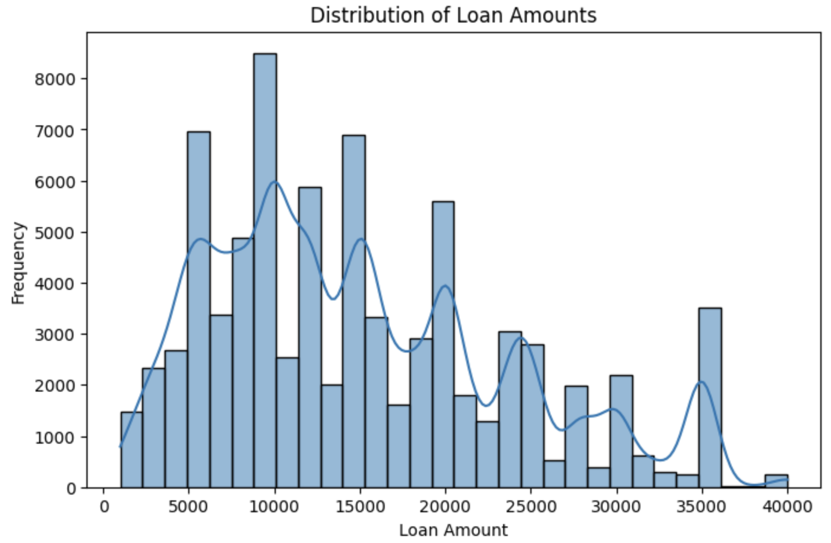
Initial Insights
Histogram
Loan amounts are heavily distributed between $5,000 to $20,000, with peaks around $10,000 and $15,000.
Higher loan amounts, such as above $30,000, are less common.
Borrowers prefer mid-range loans. Tailored policies or risk evaluations should focus on this range to identify trends and default risks.

Slide 5
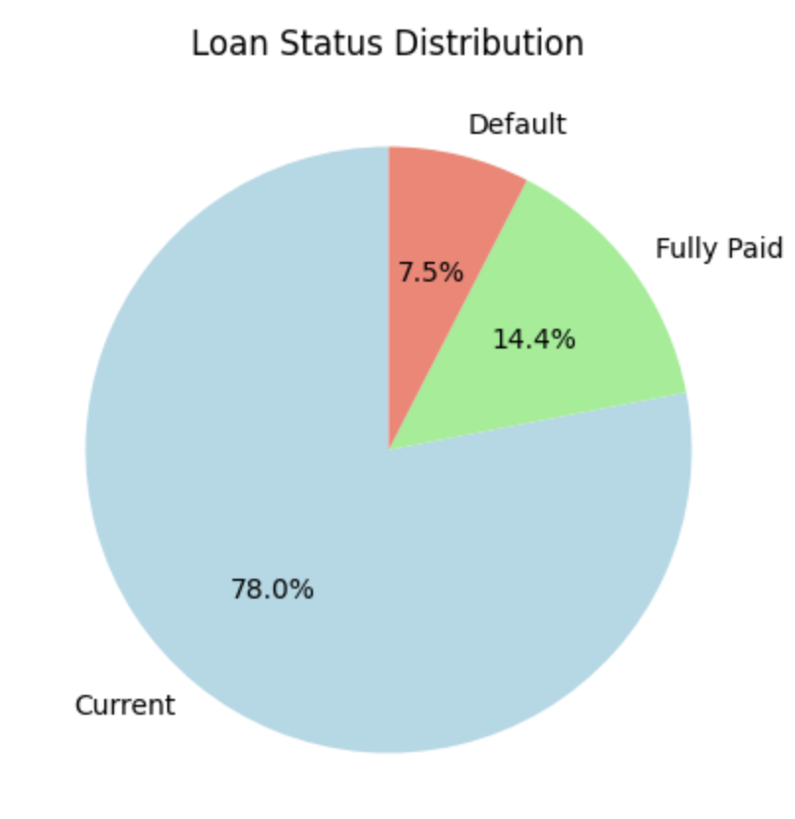
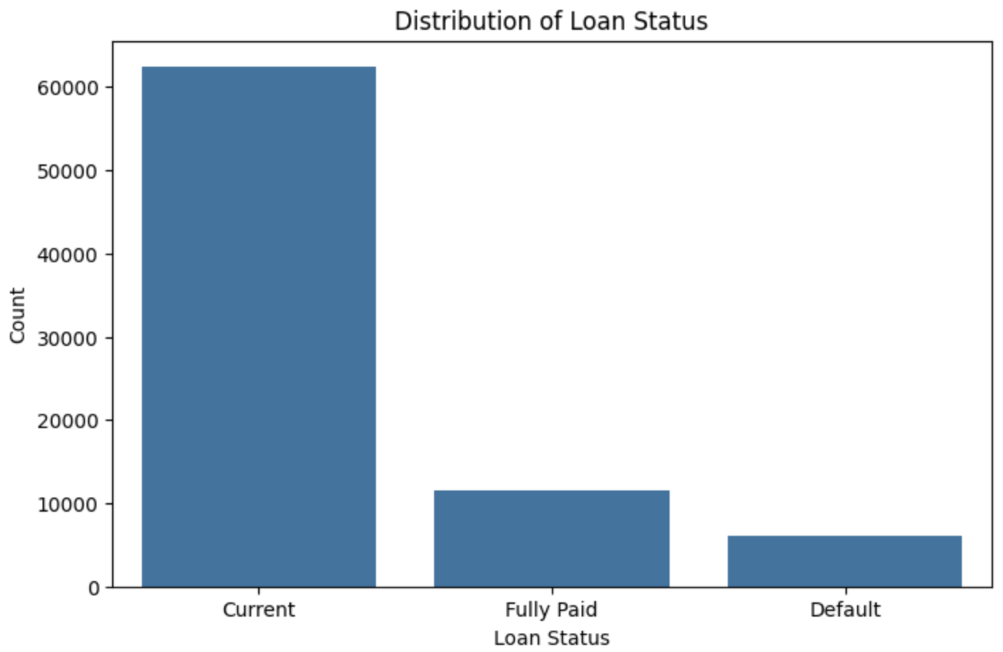
Pie Chart
Bar Chart
"Current" loans significantly outnumber other statuses. This highlights a dataset imbalance.
The default rate of 7.5% may seem small, but it represents a significant financial risk.

Slide 6
Summary Statistics
Loan Amount: (Mean: $15,055; 75th Percentile: $20,000)
Most borrowers fall into mid-range loan amounts, while higher loan amounts are rare
Installment: (Mean: $443.6 ; Min: $30.12; Max: $1,536.95)
Installment amounts align with loan amounts. Higher installments may indicate higher risks, especially if income levels don't support them.
Annual Income: (Mean: $77,790 ; 75th Percentile: $92,500 ; Max: $8.7M)
There’s a significant disparity in incomes, with some borrowers having very high incomes.
FICO Scores (fico_range_low and fico_range_high): (Average: around 694-698)
Borrowers have relatively stable creditworthiness, but a deeper investigation of defaults by FICO category is needed to validate its influence.
emp_length: 4,869 missing entries
mths_since_last_delinq and mths_since_last_record: Over 38,000 and 65,000 missing, respectively.
NOTE: Dropped rows with critical missing values (loan_amnt, installment, annual_inc).

Slide 7

Data Exploration
https://colab.research.google.com/drive/1rIHHUlERk6YBAhyzmfGD3ije_fM9MUy9#scrollTo=CweIMw8yZwtE
Default Rates: Lower-income groups have higher default rates, necessitating stricter risk management or tailored loan products.
Income Buckets: Borrowers in the $50K-$100K range dominate, indicating a target segment for loan offerings.
Verification Status: Verified borrowers have higher loan amounts, suggesting that verification correlates with loan approval policies and borrower credibility.
Policy Adjustments: Income-based policies could optimize risk-adjusted pricing and loan approvals.

Slide 8
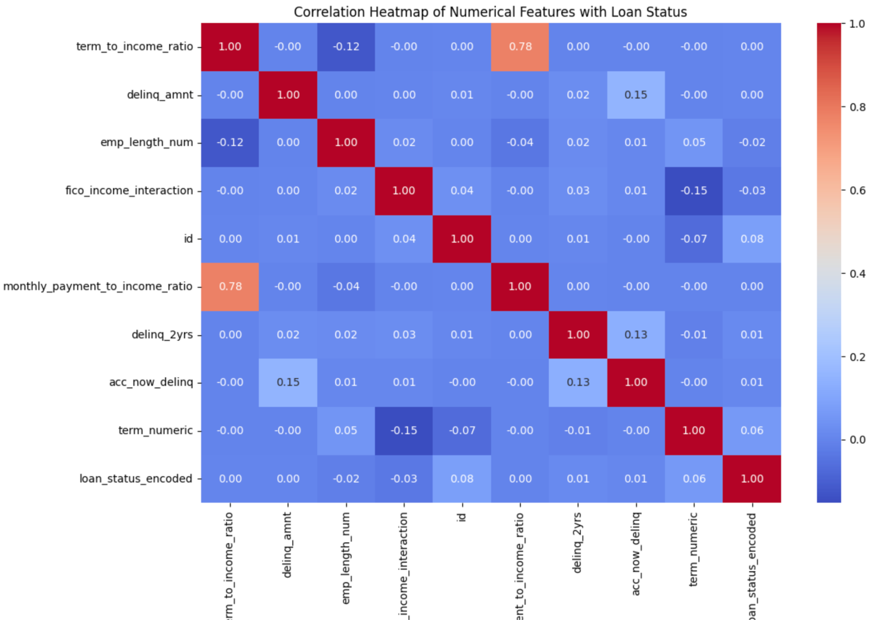
Correlation HeatMap
Monthly Payment to Income Ratio shows a strong positive correlation with Term to Income Ratio, as expected.
Minimal direct correlation exists between most numerical features and Loan Status Encoded (Current, Fully Paid, Default), suggesting the need for more advanced feature engineering to capture latent patterns.

Slide 9
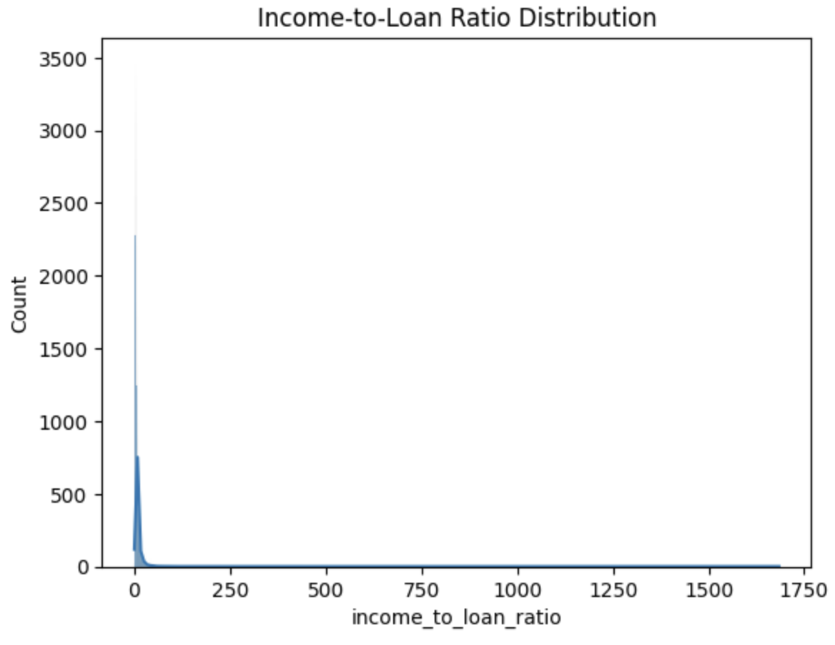
Feature Engineering
Income-to-Loan Ratio: reflects the borrower’s ability to repay the loan.
The distribution is heavily skewed to the right, with most borrowers having an income-to-loan ratio in the lower range.

Slide 10
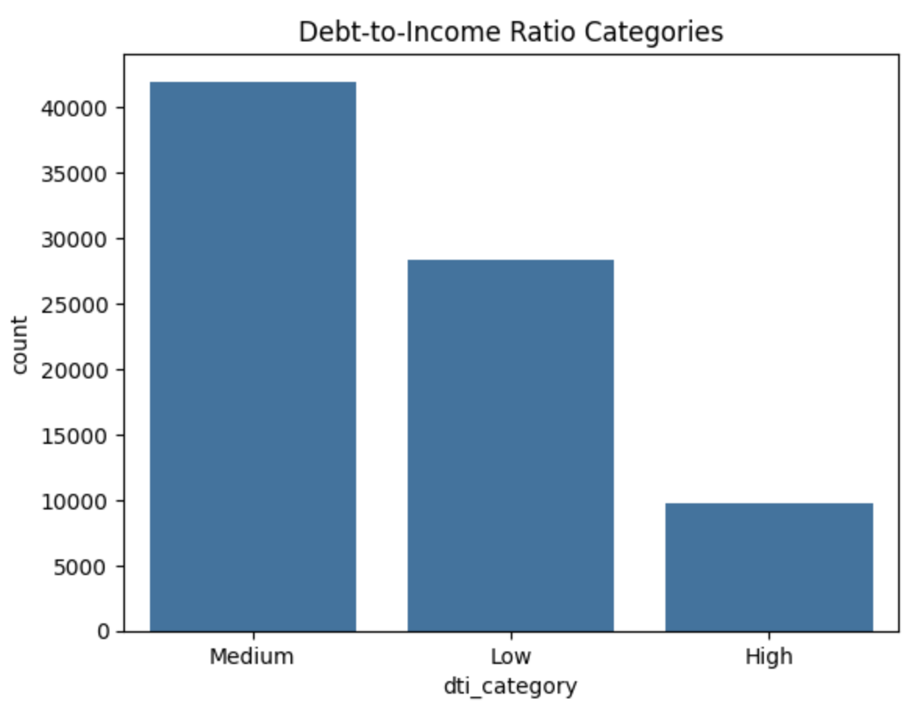
Debt-to-Income (DTI) Category : measure of the borrower’s total monthly debt obligations compared to their monthly income.
Visualization:
The majority of borrowers fall under the "Medium" category, followed by "Low" and "High". That means High DTI borrowers are more likely to default, making this feature critical for risk stratification and loan approval processes.

Slide 11
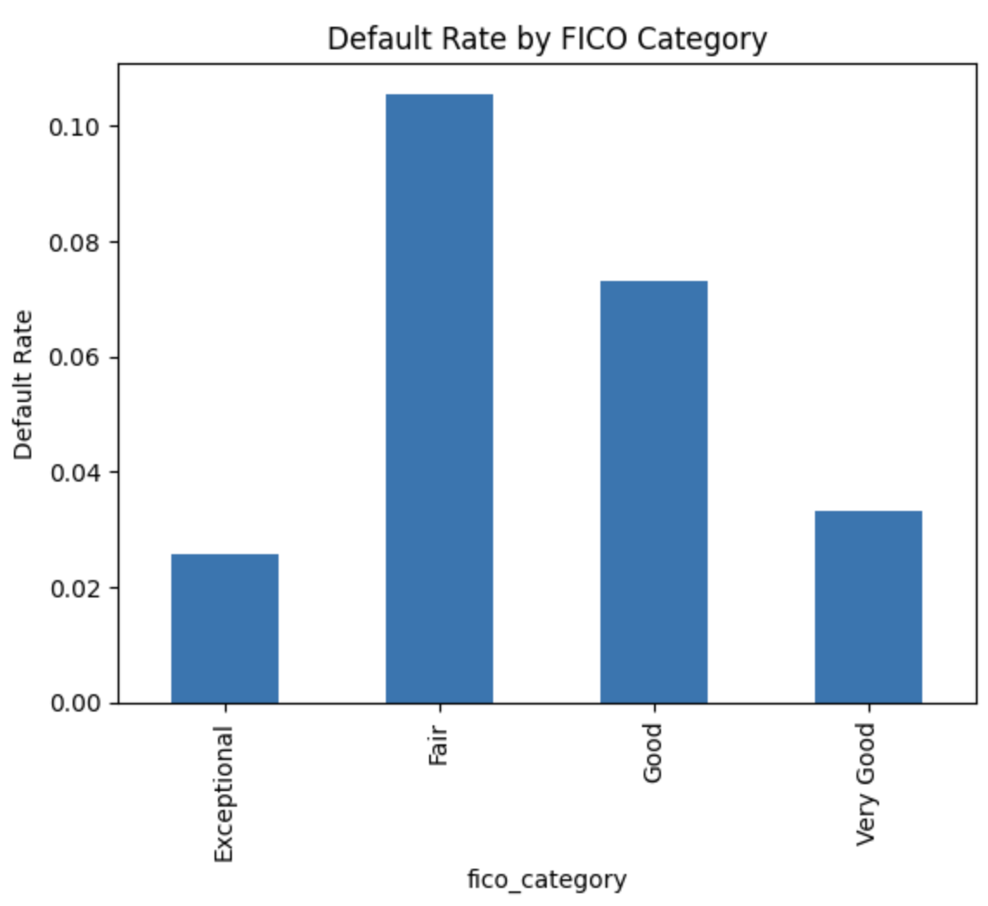
Credit Score Category (FICO): categorizes borrowers into risk tiers based on their FICO score.
Exceptional (>800): Lowest risk.
Very Good (740–799): Low risk.
Good (670–739): Moderate risk.
Fair (580–669): High risk.
Poor (<580): Very high risk.
Default rates are highest in the "Fair" category, followed by "Good".
Borrowers in the "Fair" category represent the highest default risk, emphasizing the importance of credit score as a predictor of loan repayment ability.

Slide 12
More Features…….
Employment Length Category: Categorizes borrowers based on the number of years in their current job:
Employment stability is a critical factor for lenders, as borrowers with longer employment histories are less likely to default.
Loan Term to Income Ratio: Captures how much the loan term (in years) relates to the borrower’s annual income. A higher ratio indicates a longer loan term relative to income, potentially increasing risk.
This feature can highlight long-term financial commitments that may strain a borrower’s resources, especially for those with lower incomes.
Monthly Payment to Income Ratio: Measures the percentage of the borrower’s monthly income consumed by the loan payment.
A high ratio indicates financial strain, especially if combined with other high-risk features like a low income or poor credit score.
Interaction Term (FICO Score × Income-to-Loan Ratio): Combines creditworthiness and income stability into a single feature to assess overall risk.
Borrowers with high interaction values (high FICO and income-to-loan ratios) are likely to be safer bets for lenders, while those with low values are higher risk.
Past Delinquencies Indicator: Indicates if the borrower has had delinquencies in the past two years.
Borrowers with past delinquencies are more likely to default again, making this feature a key indicator of credit risk.

Slide 13
Modeling Approaches

Slide 14
Data Preparation
The dataset contains the following key columns:
Numerical Columns: loan_amnt, installment, annual_inc, dti, etc…
Categorical Columns: home_ownership, verification_status, purpose, etc…
Missing values in numerical columns were imputed with their mean.
Successfully converted ‘term’ column from a categorical format (e.g., '36 months') to numeric, which is essential for model input.
loan_status was successfully converted into a binary target variable where Default = 1 and all others are 0.
Dummy variables were created for categorical columns like home_ownership, purpose, and addr_state. These columns were one-hot encoded (with drop_first=True to avoid multicollinearity).
Non-numeric columns like issue_d and earliest_cr_line were dropped, as they were not immediately useful.
The data split ratio in the is 70:30 for training & testing.

Slide 15
Random Forest Feature Importance
ID
Installment
Loan Amount
15.9%
14.8%
14.3%
12.6%
10.6%
DTI
Annual Income
The remaining features (e.g., fico_range_low, inq_last_6mths) have lower importance but could still contribute in ensemble methods.

Slide 16
Random Forest
Classification Report
Precision for Default (1): 0.75 indicates that 75% of the predicted defaults were correct.
Recall for Default (1): 0.00 indicates the model failed to identify defaults effectively.
Overall Accuracy: 92% is high, but this is misleading due to imbalanced data (default cases are underrepresented).
Confusion Matrix:
Most defaults (1832) were incorrectly predicted as non-default (0).
Only 3 defaults were correctly identified.
The model struggles with recall for the minority class (Default).
The high importance of ID suggests data leakage, which could skew the model's performance.
F1-Score for minority class (Default): 0.0000
ROC-AUC Score: 0.6116

Slide 17
Random Forest with New Features
Newly engineered features such as monthly_payment_to_income_ratio (13.88%), fico_income_interaction (12.39%), income_to_loan_ratio (10.57%), and term_to_income_ratio (9.21%) contribute significantly to the model.
The new features introduced additional complexity but did not provide significant benefits in addressing class imbalance.
Performance for minority class (defaults) was worse, likely due to over-reliance on new features and insufficient handling of class imbalance.
Correctly predicted 22,155 true negatives and misclassified 1,832 false negatives for the minority class, resulting in zero correctly identified defaults.
F1-Score (minority class): 0.00, showing the model completely failed to classify the minority class (defaults).
ROC-AUC: 0.61, significantly lower than the original model, indicating poor separation of the two classes.
The new features improved feature importance distribution but did not address the class imbalance issue.

Slide 18
Random forest with SMOTE
Confusion Matrix:
True Negatives (Non-Defaults Correctly Predicted): 20,938
False Positives (Non-Defaults Predicted as Defaults): 1,230
False Negatives (Defaults Predicted as Non-Defaults): 1,689
True Positives (Defaults Correctly Predicted): 143
Classification Metrics:
Precision (Default Class): 0.10
Recall (Default Class): 0.08
F1-Score (Default Class): 0.09
Accuracy: 90%
The recall for the minority class improved slightly.
The model still missclassifies a significant number of defaults as non-defaults, but it performs better in detecting defaults.

Slide 19
SMOTE with Undersampling & Hyperparameter Tuning
Classification Report
Metric | Class 0(Non-Default) | Class 1(Default)
Precision | 0.94 | 0.11
Recall | 0.70 | 0.45
F-1 Score | 0.80 | 0.18
Confusion Matrix
 | Predicted Non-Default | Predicted Default
Actual Non Default (0) | 15,574 | 6,594
Actual Default (1) | 1,008 | 824

Slide 20
Insights….
Feature Importance:
fico_range_low is the most important predictor, emphasizing the role of credit scores in distinguishing default risks.
Ratios like dti, monthly_payment_to_income_ratio, and income_to_loan_ratio are critical for capturing a borrower's financial health and loan affordability.
Challenges:
Precision for Defaults (Class 1): dropped to 11%, indicating a high number of false positives. This might burden manual reviews and increase operational costs.
Accuracy Reduction: dropped compared to earlier models (from ~92% to 68%), reflecting the trade-off between achieving better recall for defaults and maintaining overall precision.

Slide 21
IMAGINE!!!!

Slide 22
Random Forest with Standardized Features (Z-Score Normalization)
Classification Report
Metric | Class 0(Non-Default) | Class 1(Default)
Precision | 0.92 | 0.05
Recall | 1.00 | 0.01
F-1 Score | 0.96 | 0.01
Confusion matrix
 | Predicted Non-Default | Predicted Default
Actual Non Default (0) | 15,574 | 6,594
Actual Default (1) | 1,008 | 824

Slide 23
Balanced Random Forest
Classification Report
Metric | Class 0(Non-Default) | Class 1(Default)
Precision | 0.95 | 0.11
Recall | 0.59 | 0.60
F-1 Score | 0.73 | 0.18
Confusion matrix
 | Predicted Non-Default | Predicted Default
Actual Non Default (0) | 13,062 | 9106
Actual Default (1) | 727 | 1105

Slide 24
Easy Ensemble
Addresses class imbalance by creating balanced datasets through undersampling the majority class (non-defaults). It then trains multiple AdaBoost classifiers on these balanced datasets and aggregates their predictions.
Classification Report
Metric | Class 0(Non-Default) | Class 1(Default)
Precision | 0.94 | 0.11
Recall | 0.59 | 0.58
F-1 Score | 0.73 | 0.18
Confusion matrix
 | Predicted Non-Default | Predicted Default
Actual Non Default (0) | 13,175 | 8993
Actual Default (1) | 767 | 1065

Slide 25
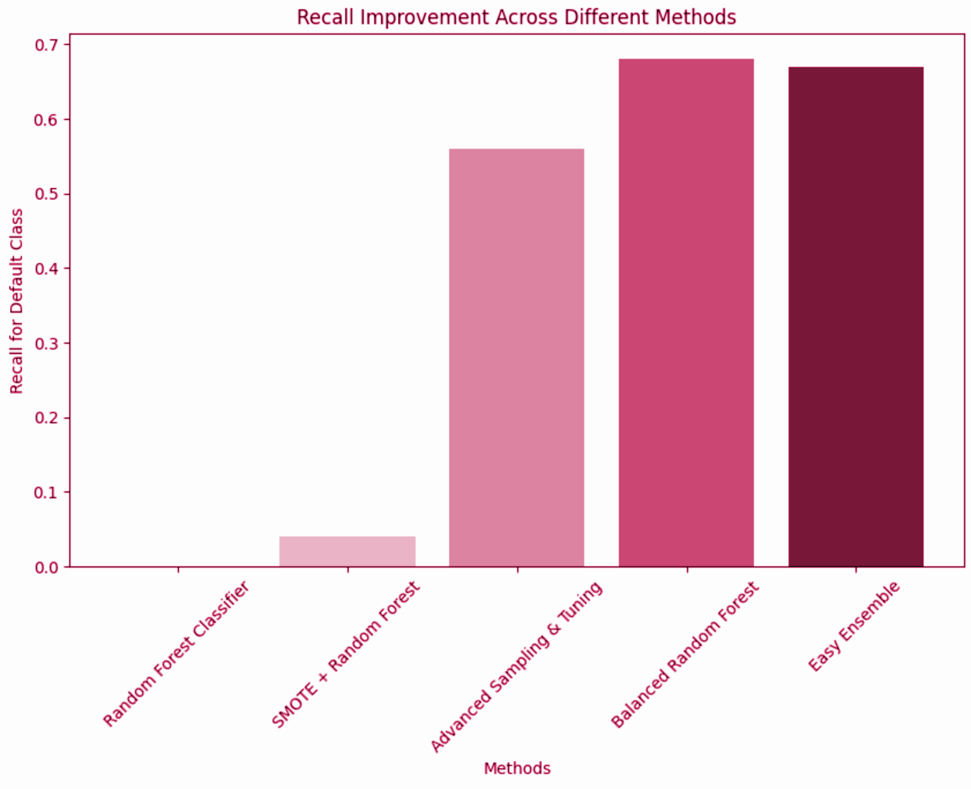
Recall Improvement Graph

Slide 26
Logistic Regression
(balanced class weights)
Classification Report
Metric | Class 0(Non-Default) | Class 1(Default)
Precision | 0.95 | 0.10
Recall | 0.56 | 0.62
F-1 Score | 0.70 | 0.18
Confusion matrix
 | Predicted Non-Default | Predicted Default
Actual Non Default (0) | 12,342 | 9826
Actual Default (1) | 699 | 1133

Slide 27
Logistic Regression
(Scaled Pipeline)
Classification Report
Metric | Class 0(Non-Default) | Class 1(Default)
Precision | 0.94 | 0.10
Recall | 0.57 | 0.60
F-1 Score | 0.71 | 0.18
Confusion matrix
 | Predicted Non-Default | Predicted Default
Actual Non Default (0) | 12,645 | 9523
Actual Default (1) | 738 | 1094

Slide 28
Hyperparameter Tuning of LR
C = 1: standard level of regularization ; solver = lbfgs: The LBFGS solver is well-suited for small to medium-sized datasets and converges effectively.
Recall for defaults is 60%, indicating the model successfully identifies 60% of actual defaults.
The F1-score for defaults is 18%, reflecting poor balance between precision and recall for this class.
GridSearchCV ensures the model parameters are optimized, leading to slightly better balance in predictions.
The pipeline automates scaling and modeling, ensuring consistent preprocessing and reducing the risk of data leakage.

Slide 29
XGBoost (scale_pos_weight)
scale_pos_weight: This parameter balances the classes by penalizing misclassification of the minority class more heavily, improving recall for defaults.
Classification Report
Metric | Class 0(Non-Default) | Class 1(Default)
Precision | 0.94 | 0.13
Recall | 0.76 | 0.41
F-1 Score | 0.84 | 0.19
Confusion matrix
 | Predicted Non-Default | Predicted Default
Actual Non Default (0) | 16941 | 5227
Actual Default (1) | 1080 | 752

Slide 30
Hyperparameter Tuning (XGBoost)
Classification Report
Metric | Class 0(Non-Default) | Class 1(Default)
Precision | 0.95 | 0.12
Recall | 0.70 | 0.52
F-1 Score | 0.80 | 0.20
Confusion matrix
 | Predicted Non-Default | Predicted Default
Actual Non Default (0) | 15444 | 6724
Actual Default (1) | 876 | 956

Slide 31
Fine Tuning (XGBoost)
learning_rate = 0.05: A lower learning rate slows down the learning process, helping the model converge more effectively without overfitting.
max_depth = 5: A smaller depth avoids overfitting and focuses on more general patterns.
scale_pos_weight = 10: This parameter adjusts for the class imbalance, giving more weight to the minority class (defaults).
gamma = 0.2: Adding a moderate regularization penalty for overly complex splits helps improve model generalization.
Classification Report
Metric | Class 0(Non-Default) | Class 1(Default)
Precision | 0.94 | 0.14
Recall | 0.78 | 0.42
F-1 Score | 0.85 | 0.20
Confusion matrix
 | Predicted Non-Default | Predicted Default
Actual Non Default (0) | 17231 | 4937
Actual Default (1) | 1061 | 771

Slide 32
Support Vector Machine
(Interpretable model with simpler kernels)
Strengths:
Best recall for defaults (62%); it identifies more defaults than any other model.
ROC-AUC (0.6689) is the highest among the models, showing better discriminatory power.
Maintains a reasonable trade-off between identifying defaults and not misclassifying non-defaults.
Weaknesses:
Precision for defaults is still very low (12%).
Accuracy (61%) is the lowest due to a significant number of false positives.

Slide 33
XGBoost with Adjusted Threshold
(Refined feature engineering)
Strengths:
Improved recall for defaults (31% compared to 0% in the Hybrid Model).
Balances recall and precision better for the minority class (F1-score = 0.20 for defaults).
ROC-AUC (0.6567) shows moderate ability to discriminate defaults and non-defaults.
Precision is slightly higher than the SVM for defaults.
Weaknesses:
Defaults are still under-identified; precision for defaults remains low at 15%.
Accuracy drops to 81% due to more false positives for defaults.

Slide 34
XGBoost with Stacking Ensemble
(Combination of models)
Strengths:
Excellent recall and precision for the majority class (non-defaults).
Ensures non-defaults are rarely misclassified as defaults.
High accuracy (92%) due to the large proportion of non-defaults in the dataset.
Weaknesses:
The model entirely fails to identify defaults (recall = 0 for defaults).
Precision for defaults is also 0, showing the model heavily overfits to the majority class.
Poor ROC-AUC (0.6478), indicating subpar discriminatory ability between defaults and non-defaults.

Slide 35
XGBoost with SVM (Hybrid)
(weighted voting)
Strengths:
Excellent recall and precision for the majority class (non-defaults).
Ensures non-defaults are rarely misclassified as defaults.
High accuracy (92%) due to the large proportion of non-defaults in the dataset.
Weaknesses:
The model entirely fails to identify defaults (recall = 0 for defaults).
Precision for defaults is also 0, showing the model heavily overfits to the majority class.
Poor ROC-AUC (0.6478), indicating subpar discriminatory ability between defaults and non-defaults.

Slide 36
Analysis of the Hybrid Model
The precision for defaults (1) is 15%, indicating that only 15% of the predicted defaults are actual defaults.
The recall for defaults is 27%, meaning the model is identifying about 27% of the actual defaults.
The F1-score for defaults is 19%, reflecting the balance between precision and recall. It's still low, suggesting that both metrics need enhancement.
The overall accuracy is 82%, but this metric is less meaningful for an imbalanced dataset since the majority class (non-defaults) dominates.
The ROC-AUC score is 0.57, which is marginally better than random guessing (0.5). This indicates that the model struggles to differentiate between defaults and non-defaults effectively.
19,271 true negatives, meaning the model correctly identified non-defaults & 495 true positives, where defaults were correctly identified.

Slide 37
Results & Recommendations
max growth

Slide 38
Best Performing Models
XGBoost (Fine-Tuned):
Precision: 15% for defaults.
Recall: 31% for defaults.
ROC-AUC: 0.65.
Captures nuanced patterns in the data and identifies key predictors.
Hybrid Model (XGBoost + SVM):
Precision: 15% for defaults.
Recall: 27% for defaults.
ROC-AUC: 0.57.
Leverages XGBoost for feature importance and SVM for recall improvement but needs further fine-tuning.
SVM:
Precision: 12% for defaults.
Recall: 62% for defaults.
ROC-AUC: 0.67.
Strong recall for defaults, better at identifying at-risk loans but at the cost of precision.

Slide 39
Final Insights
Loan Term Impact: Default rates are much higher for 60-month loans, indicating significant repayment challenges for longer terms.
Income Buckets and Default Rates: Borrowers in low-income brackets (0-25K and 25K-50K) have disproportionately high default rates, despite smaller loan sizes.
Loan Purpose Risks: Loans for renewable energy and small businesses show the highest default rates, highlighting the need for stricter controls.
Feature Importance: Metrics like FICO scores, DTI, and payment-to-income ratios are powerful predictors, emphasizing affordability and creditworthiness as key factors.
XGBoost Fine-Tuning: Hyperparameter-tuned XGBoost models offer improved recall for default predictions, making them actionable for early detection.

Slide 40
Credit Risk Assessment
Actions | Impact
Mandatory Verification | Reduces default rates across loan purposes.
Risk-Based Pricing | Improves profitability for high-risk loans.
Debt-to-Income Monitoring | Identifies high-risk borrowers proactively.
Loan Size Caps | Prevents overextension in risky segments
Borrower Segmentation | Enables targeted strategies for hidden risks.
FICO-Based Incentives | Encourages lower-risk borrower applications.

Slide 41
Credit Risk Recommendations
Make income and employment verification mandatory for high-risk loan purposes like Debt Consolidation, Credit Card, and Small Business.
Apply stricter eligibility criteria for higher-risk loan purposes & consider implementing loan amount caps for riskier categories.
Introduce risk-based pricing: Charge higher interest rates for loan purposes with historically higher default rates.
Use Debt-to-Income (DTI) ratio and Income-to-Loan ratio as key metrics in loan approval decisions, implement automated alerts where these ratios exceed a defined threshold.
Introduce loan size limits for borrowers with lower FICO scores.
Develop specific credit policies for high-risk segments based on historical trends.
Introduce targeted risk-mitigation measures, such as enhanced borrower education or offering credit insurance.

Slide 42
Technical Recommendations
Deploy the fine-tuned XGBoost model for initial implementation due to its balanced performance and explainability & use the hybrid model for cross-validation.
Adjust thresholds dynamically based on business needs:
Higher precision: Minimize defaults flagged unnecessarily (false positives).
Higher recall: Capture at-risk loans even if it increases false positives.
Apply cost-sensitive policies informed by model predictions:
Tighten credit requirements for high-risk loans.
Offer smaller loans or higher interest rates for borrowers flagged by the model.
Use fico_range_low and monthly_payment_to_income_ratio as key features in underwriting decisions.
Monitor new features such as dti_fico_interaction for further insights into borrower risk.
Retrain the model periodically to incorporate new data and adapt to changing borrower behavior.
Continuously monitor feature importance for shifts in key predictors.

Slide 43

Final Outcome
The final outcome of this project is a predictive model framework that:
Identifies 27% of defaults (recall).
Reduces false positives for non-defaults through 15% precision for defaults.
Highlights critical borrower features, such as FICO scores and income ratios, for actionable underwriting decisions.
Enables stakeholders to minimize loan portfolio risk and focus recovery efforts on high-risk borrowers.

Slide 44
THANK
YOU!!

